Slide 1

coatimunde
Design Overview
By Kara Stephan and Navarre Hebb

Slide 2
Overview
Problem Description
Design Overview
Scheduling
Risks & Issues

Slide 3
coatimunde
Computer Optics
Analyzing Trajectories In
Mostly Unknown,
Navigation Denied, Environments

Slide 4
Background
Obstacle Avoidance
Unmanned Aircraft Systems
Computer Vision
Robot Operating System (ROS)

Slide 5
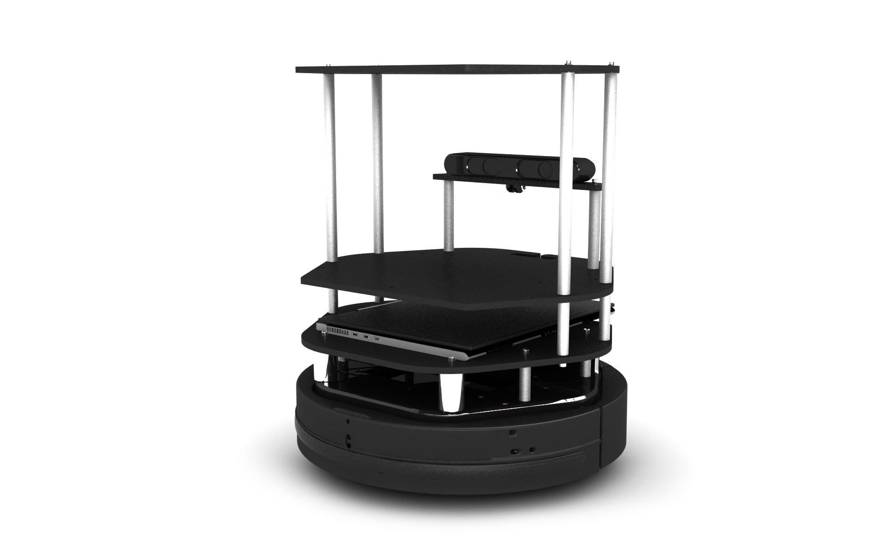
Requirements
Movement Toward Target
Identification of Target
Identification of Obstacle
Avoiding Obstacles
Multiple Obstacles

Slide 6
Scope
Small Robotics Laboratory
  Lower Speeds
  Smaller Obstacles
ArUco Marker
Require only input to commence

Slide 7
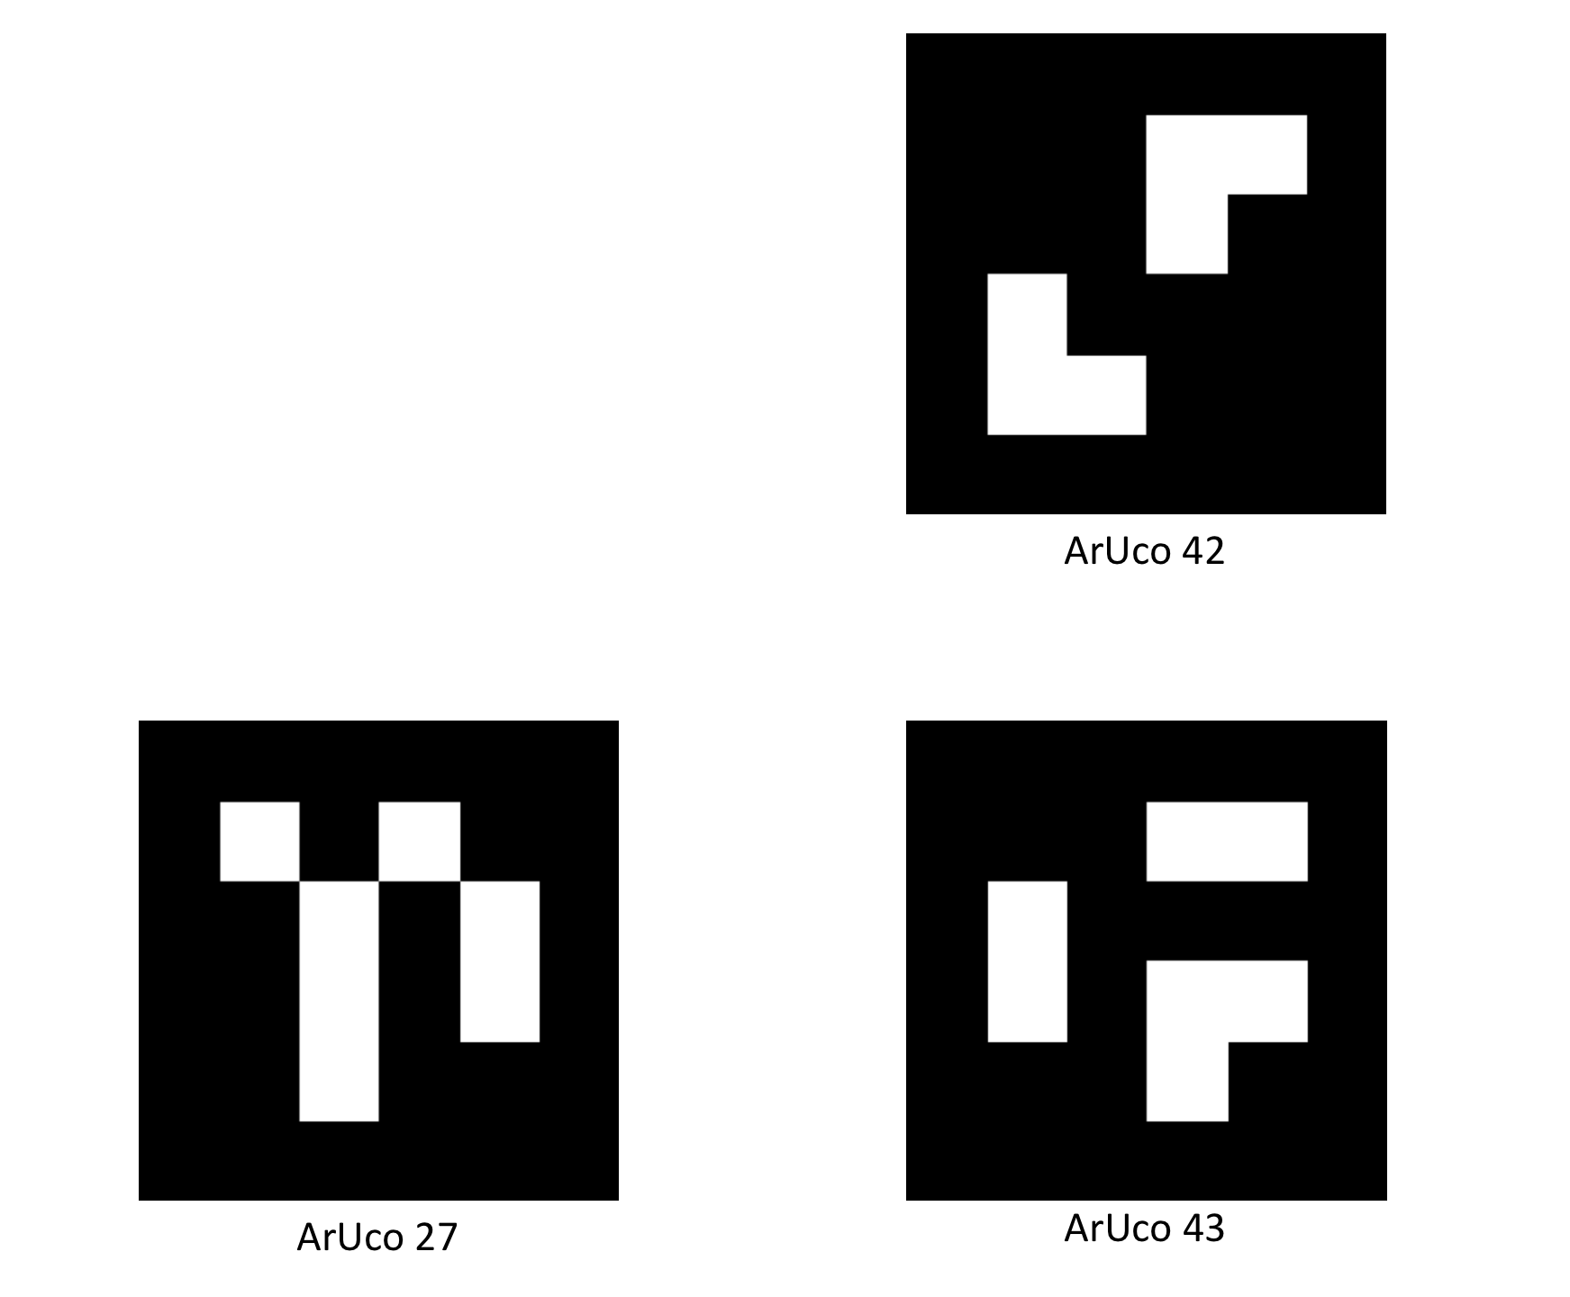
Design Overview
Existing Software
  Robot Operating System
  Many ROS Nodes
  Gazebo
  OpenCV
  ArUco

Slide 8
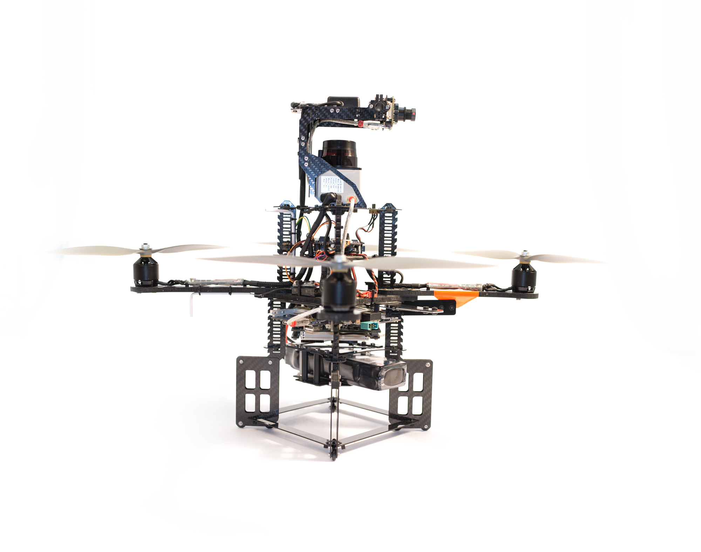
Design Overview
Existing Hardware
  TurtleBot
  AscTec Pelican
  Platform Agnostic

Slide 9
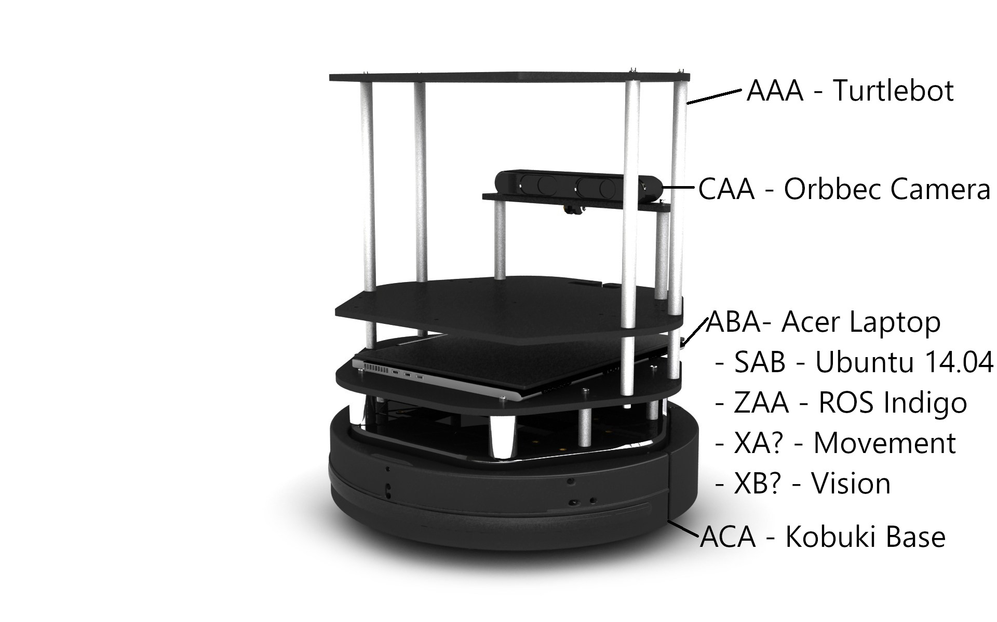
Equipment List

Slide 10
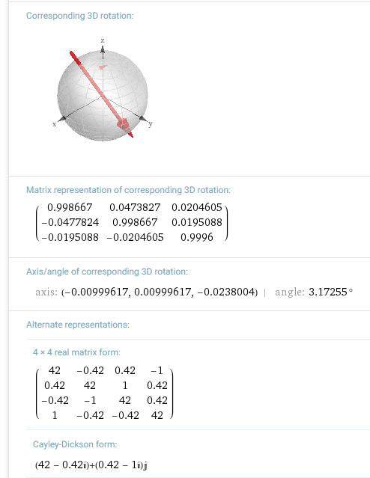
Mathematical Modeling
Flying Robot
Robot in 3D Space
Pose Estimation

Slide 11

System Architecture
ROS/Patterns
  ROS Enhancement Proposals
ROS/BestPractices
  Needed Best Practices
  Package Organization
  Custom Nodes, Messages, and Services

Slide 12
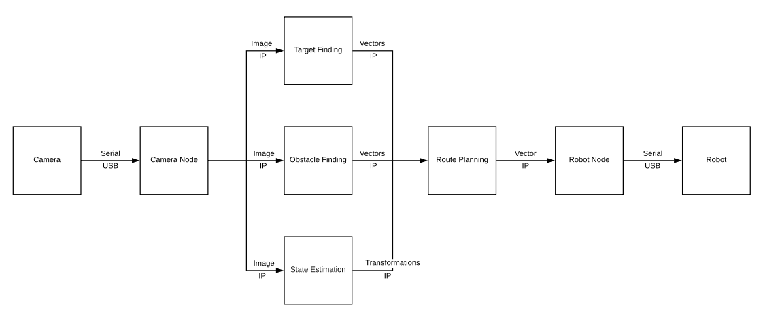
Simplified Diagram

Slide 13
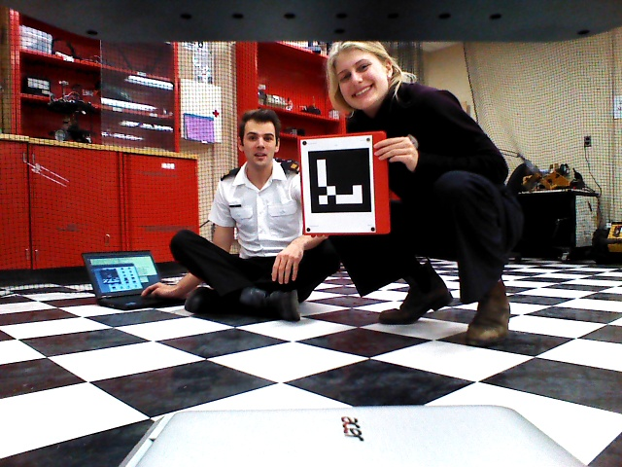
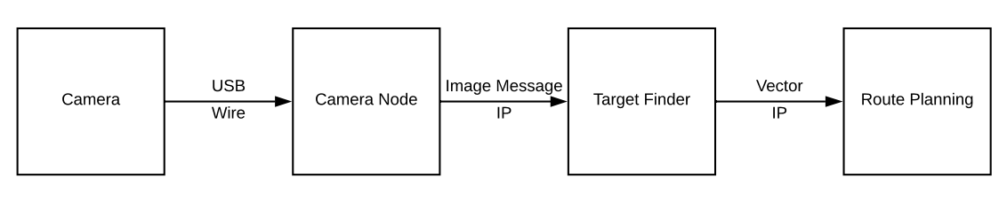
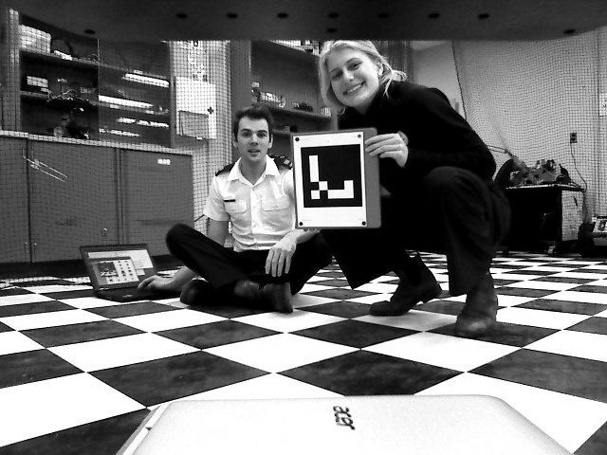
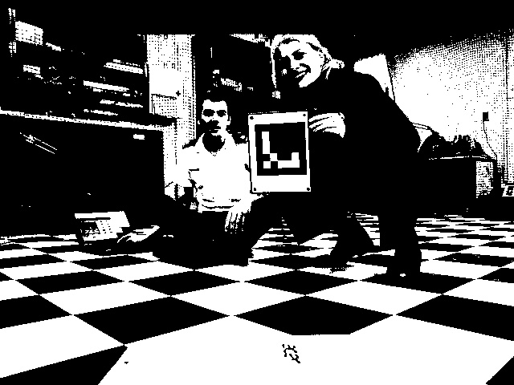
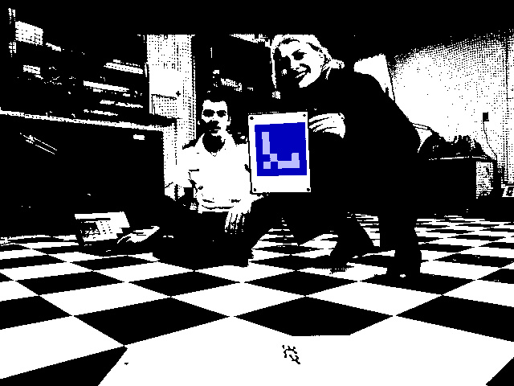
Target Finding
ArUco Library
Written in Python and C++
Input: Camera Information
Output: Vector to Marker

Slide 14

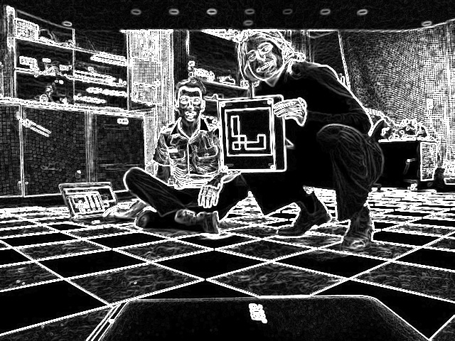
Obstacle Finding
OpenCV
  Sobel, Basic Math, Parallax Shift
Written in Python
Input: Camera
Output: Vectors to Edges

Slide 15

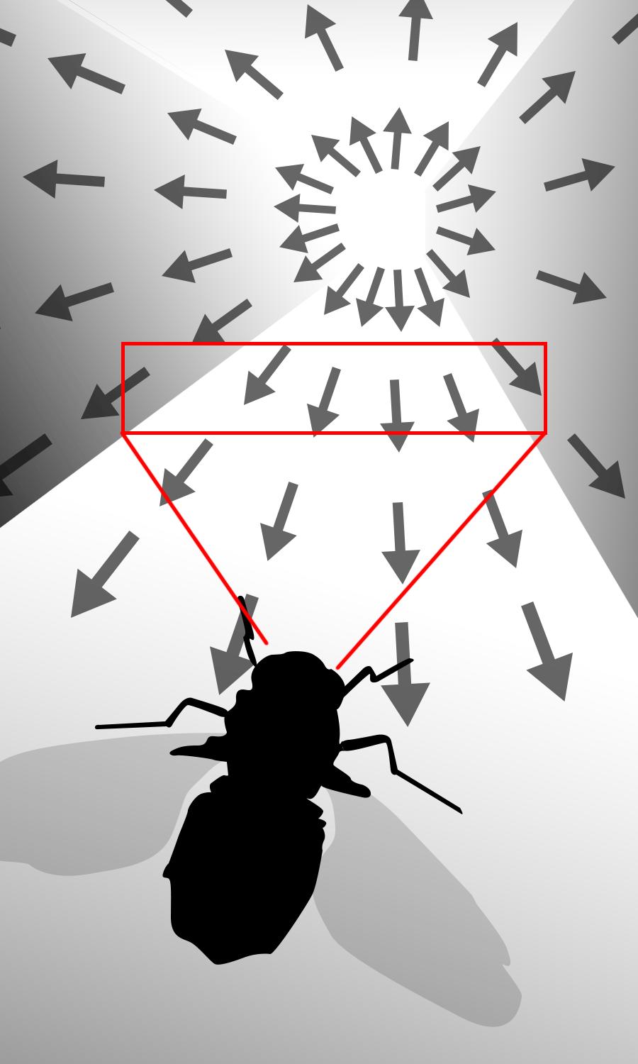
State Estimation
Written in Python
Input: Initially Sensor Data
  Ideally Camera Data
Output: Transformation Vectors

Slide 16
Simplified Diagram

Slide 17
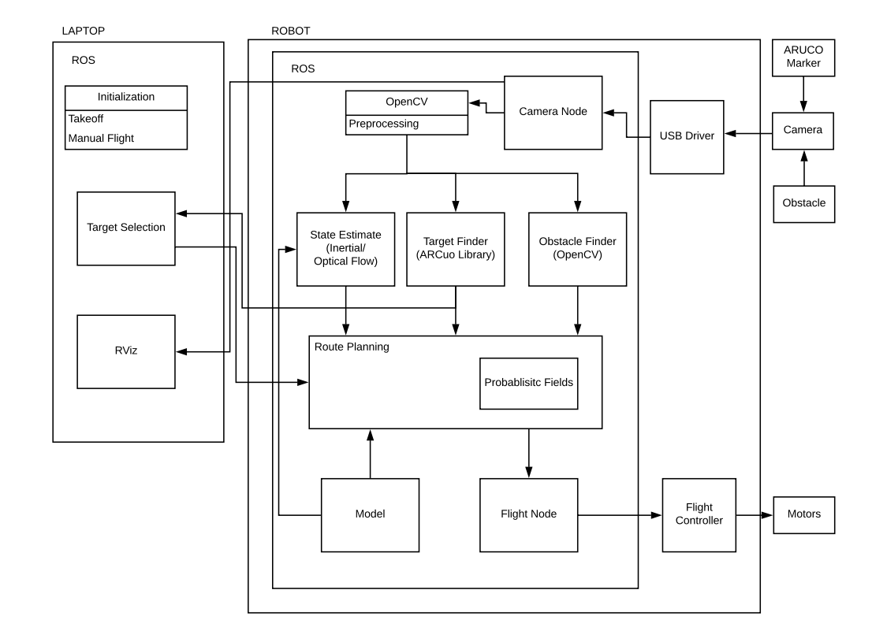

Slide 18
Verification and Validation
Individual Nodes
Nodes Interacting
Gazebo
Observing Robot in Lab
Tracking Robot in Lab

Slide 19
Schedule Milestones
Turtlebot Finished – Feb 20th, 2019
  Move towards Target - Nov 30th, 2019
  Avoid Obstacles – Jul 10th, 2019
  Obstacle Memory – Feb 20th, 2019
Port to UAV – April 28th, 2019

Slide 20
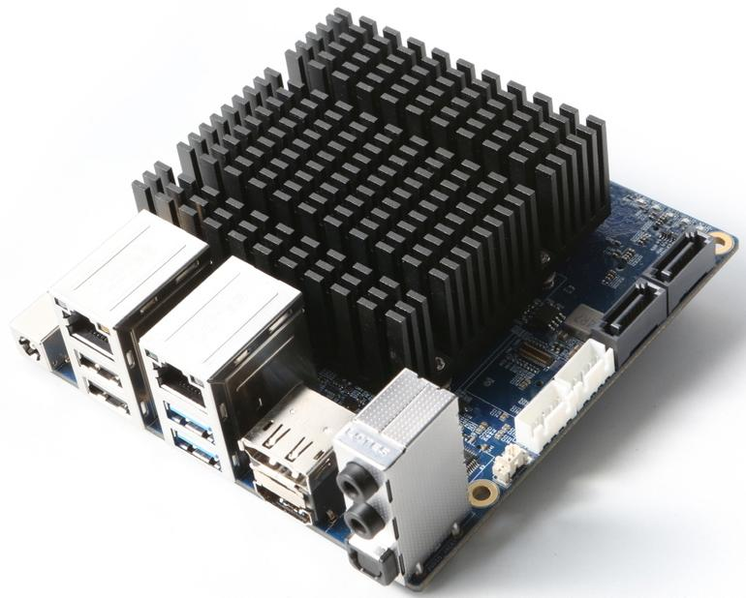
Risks and Issues
Small Lab
Identifying Markers
Flight Control System
Computer Hardware Limitations

Slide 21
Summary
Problem Description
Design Overview
Scheduling
Risks & Issues

Slide 22
Thank You!
Questions?

